Slide 1

Project Title – Seasonal Agriculture Performance Analysis
Student Name -
College Name -
DURGA PRASAD ANNAMDEVULA
Aditya Degree College Rajamahendravaram
AICTE STU ID :
STU676bea311090a1735125553

Slide 2

PROBLEM STATEMENT
Agricultural activities are influenced by seasonal variations in environmental conditions, farming practices, resource availability and market conditions. As a result, agricultural performance may differ from one season to another. However, raw agricultural data does not clearly explain how agricultural performance changes across seasons or what patterns can be observed in different seasonal conditions. The problem is to analyze the given agricultural dataset and investigate seasonal differences in agricultural performance by identifying meaningful patterns, trends, relationships and variations within the available data.

Slide 3
Project Description
[write detail description about your project ]
This Project Analyzes Seasonal Agricultural Performance By Studying Environmental Conditions, Resource Usage, Crop Production, And Economic
Outcomes To Identify Key Patterns And Trends.
The Findings Provide Useful Insights For Better Agricultural Planning And Decision – Making Across Seasons.

Slide 4

WHO ARE THE END USERS?
Farmers: To understand crop performance and improve farming decisions.
Agricultural Officers: To support agricultural planning and guidance.
Researchers: To study seasonal and crop yield patterns.
Government & Policy Makers: To make data-driven agricultural policies.
Agribusinesses: To plan resources based on crop production trends.

Slide 5

Technology Used
  Python – Data Analysis And Processing.
  Pandas – Data Cleaning And Manipulation.
  Numpy – Numerical Operations.
  Matplotlib - Data Visualization.
  Seaborn - Statistical Data Visualization.
  Google Collab – Coding And Project Execution.
  Jupyter Notebook – Project Development And Documentation.

Slide 6
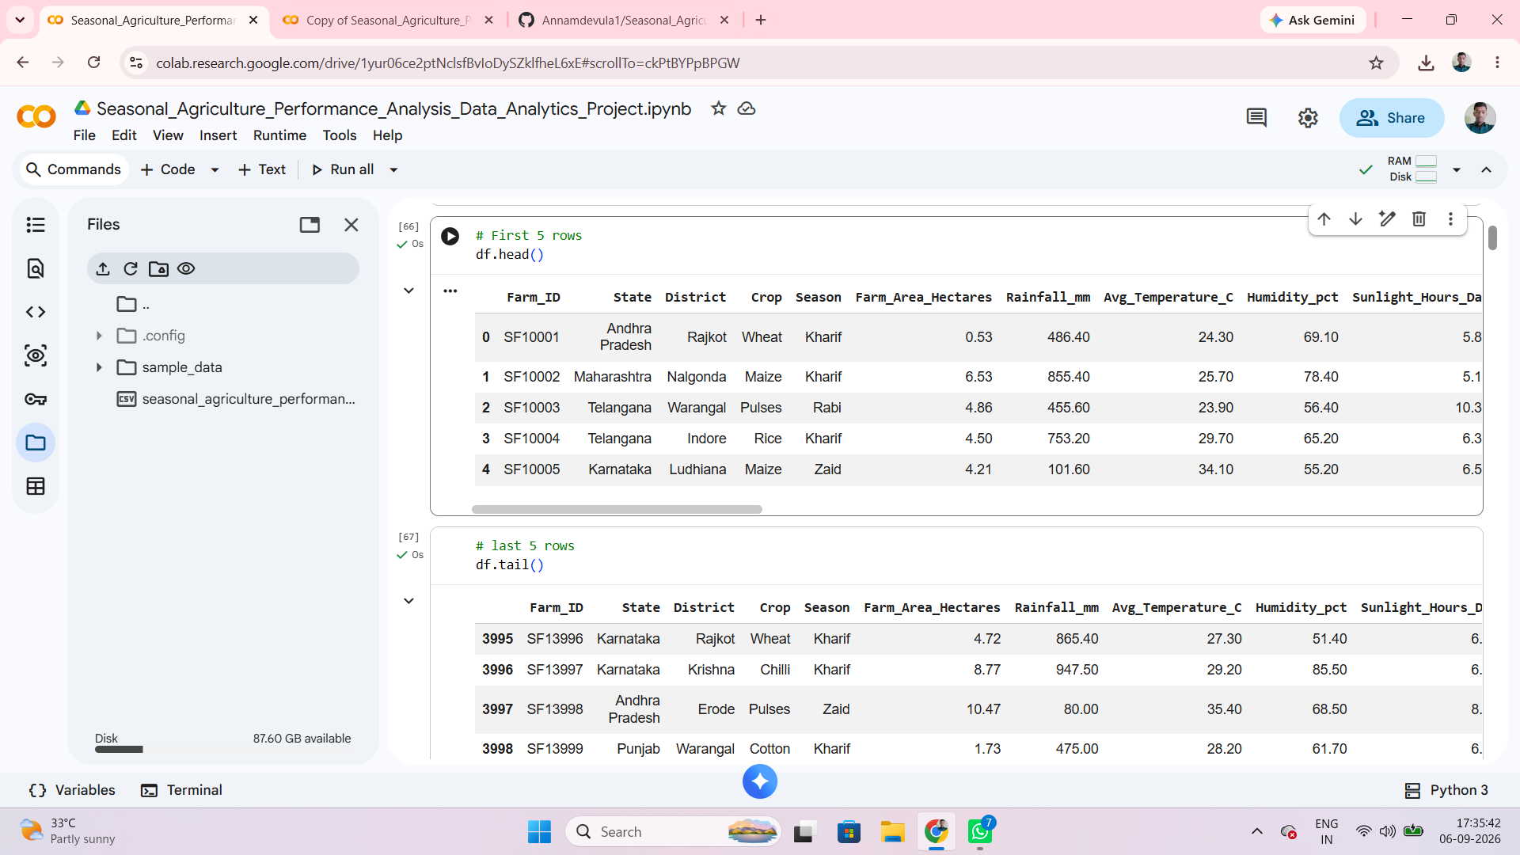
RESULTS

Slide 7
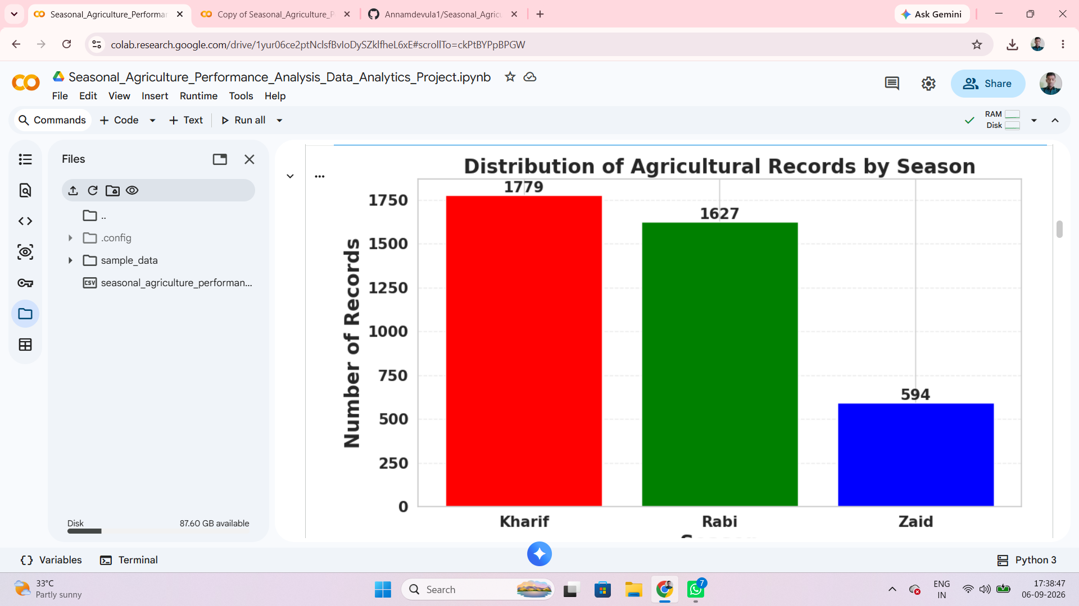
RESULTS
[Add screen shots of your code ]
Kharif Has The Highest Number Of Agricultural Records, zaid is lowest.

Slide 8
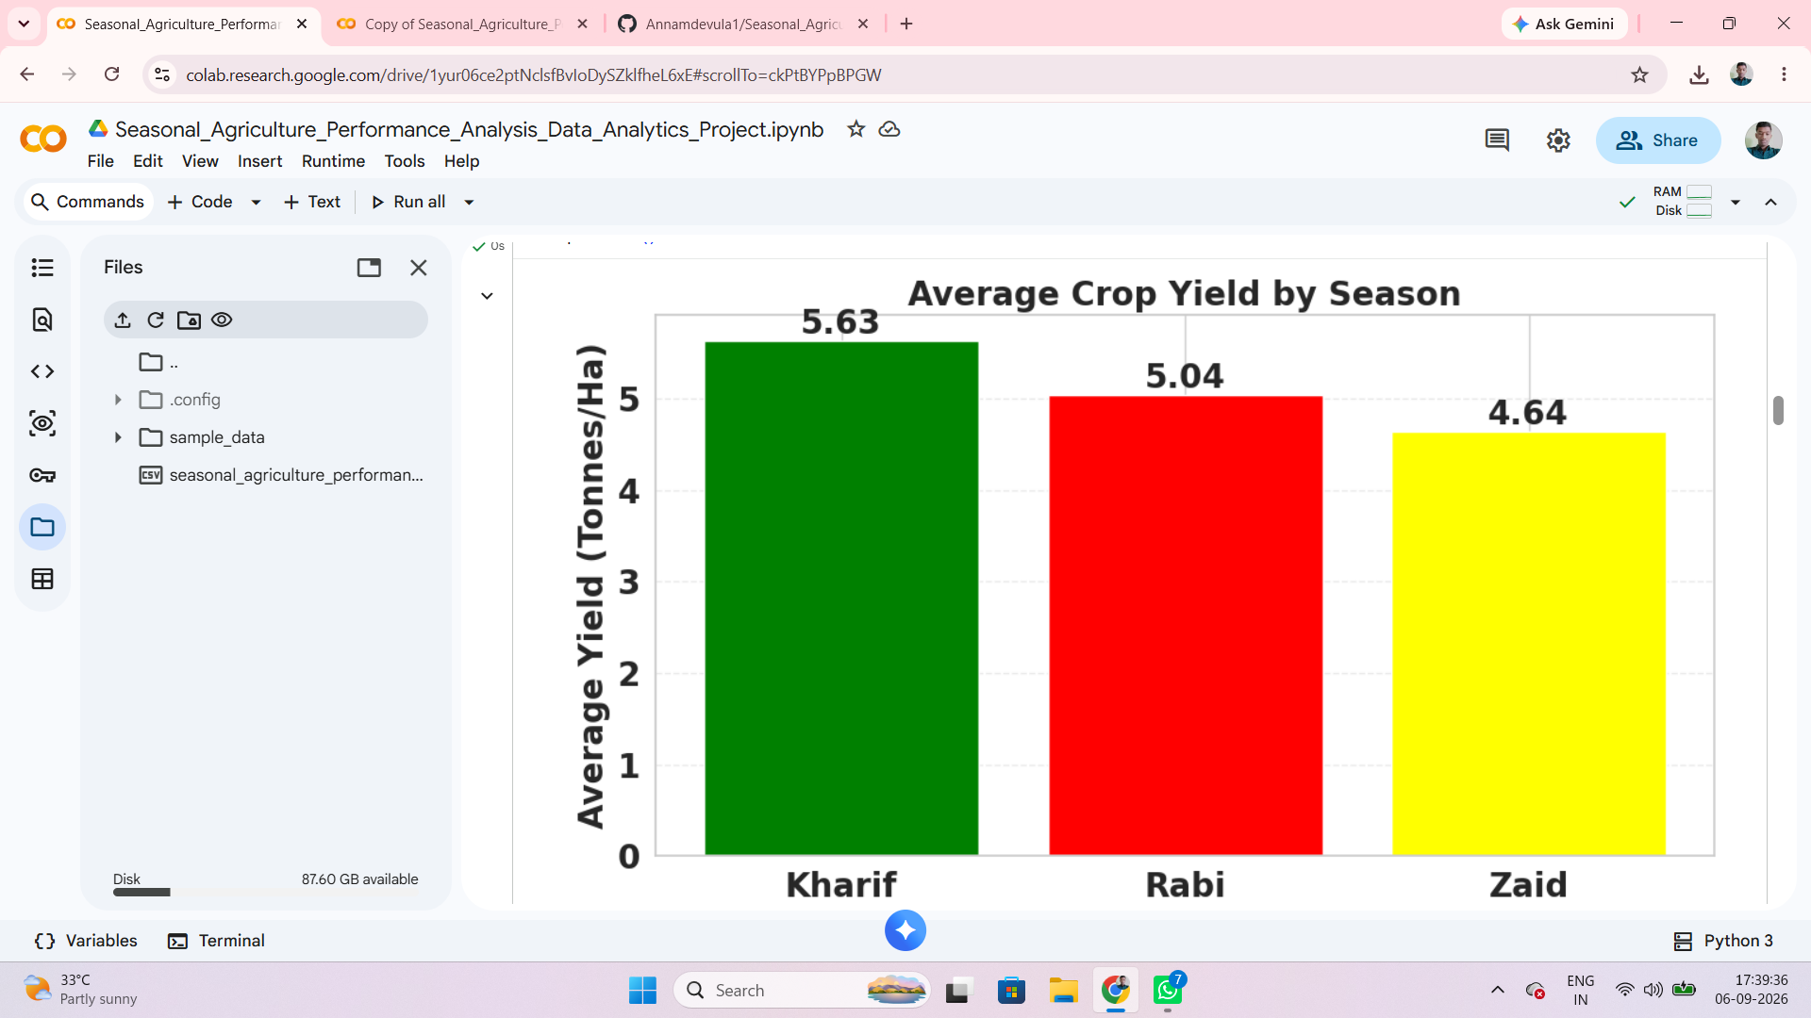
RESULTS
[Add screen shots of your code ]
Kharif shows the Highest Average Field(5.63 tonnes/ha), followed by Rabi And Zaid.

Slide 9
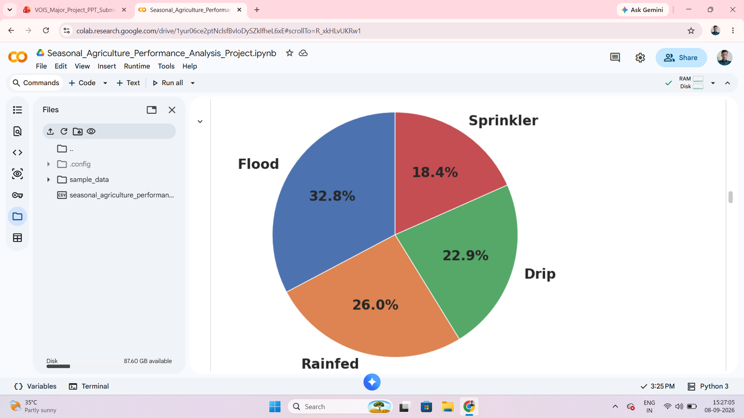
RESULTS
[Add screen shots of your code ]
Distribution of Irrigation Methods
Flood Irrigation is the Most Commonly used Method(32.8%), while Sprinkler irrigation is
Low.

Slide 10
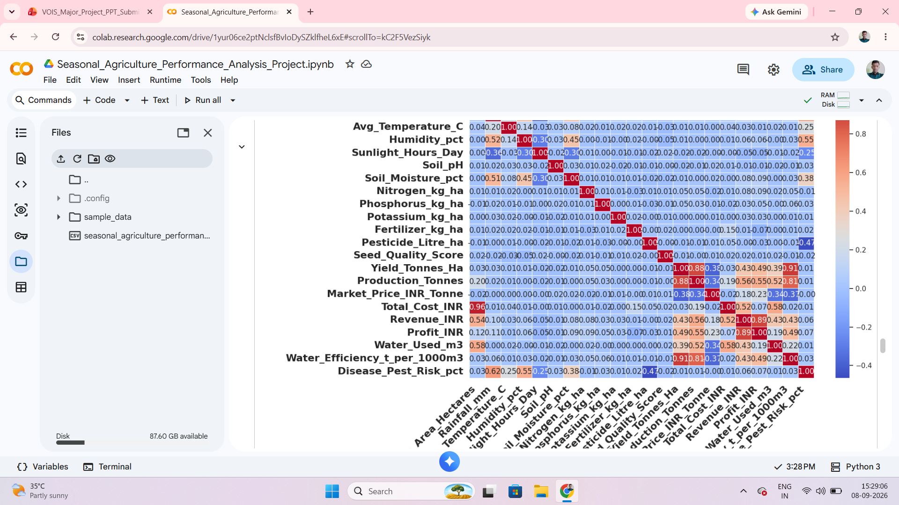
RESULTS
[Add screen shots of your code ]
The Heatmap Shows the Relationships between different Agricultural Variables.

Slide 11
Future scope
Helps farmers choose suitable crops and seasons based on past agricultural performance.
Supports better use of water and other farming resources.
Can be extended with AI/ML to predict future crop yield and profitability.
Helps in better agricultural planning and decision-making.
Helps identify the best-performing seasons for agricultural activities.
Supports comparison of crop performance across different seasons and regions.
Helps understand the impact of rainfall and temperature on crop productivity.
Can support water-use planning by using water-efficiency analysis.
Helps identify factors affecting agricultural profitability.
Can be expanded with real-time agricultural data for continuous monitoring.
Can help farmers reduce unnecessary resource usage through data-based planning.
Can support government and agricultural planners in making better seasonal decisions.
Can be developed into a farmer-friendly dashboard or mobile application.
Future predictions can help farmers plan before the cropping season begins.

Slide 12
GitHub Link
https://github.com/Annamdevula1/Seasonal_Agriculture_Performance_Analysis_Project.git

Slide 13

VOIS Course completion certificate -
Course name- Data Visualization

Slide 14
Thank you
.
.

